Slide 1
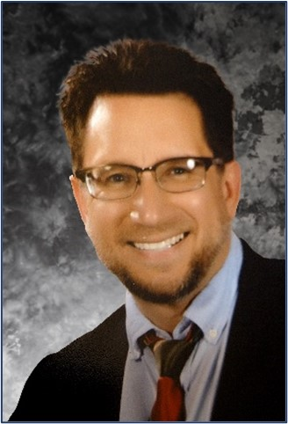
Meet the Presenter
Mr. Vince Chermak is the Assurance Director for the Versatile Test Reactor (VTR) Project based at Idaho National Laboratory. He has enjoyed more than 20 years in Nuclear Quality Assurance that spans the U.S. Department of Energy, Naval Nuclear Propulsion Program, U.S. Commercial Nuclear, ISO, and Nuclear Waste Management industries. He is the INL representative to the IAEA for Supply Chain Management Toolkit development initiative. He also serves as a member of the ASME NQA-1 Subcommittee on International Activities. Mr. Chermak earned a B.S. in Physics and a B.A. Ed. in Mathematics and Physics from The University of Akron.
Mr. Chermak firmly believes that one manages things and leads people. Leadership is not a position; it is a decision. Each of us has the responsibility to employ everything in our capacity to bring one another together and walk toward excellence. The most important things we as Leaders can do are recognize and leverage one another's strengths, rather than categorize each other by our differences.
Email: alois.chermak@inl.gov

