Slide 1
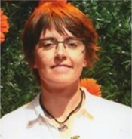
Meet the Presenter
Dr. Flore Villaret recently completed her PhD at the French Atomic Energy Commission (CEA) in the field of materials sciences (metallurgy). She is now a research engineer at the R&D Department of Electricité de France (EDF). She works on developing additive manufacturing of metal components for energy applications such as nuclear reactors and hydraulic power generation. She is also vice president of the French metallurgy and material society young division. She won the 2021 Pitch your Gen IV research competition with a very creative and original video presenting her PhD work in additive manufacturing metallurgy for Gen IV reactors (available at https://www.youtube.com/watch?v=v2IiEHMVyGc ). She was also awarded by the French metallurgy and material society with the Bodycote best PhD thesis award.

