Slide 1
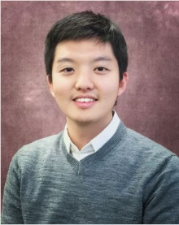
Meet the Presenter
GEN IV International Forum
Dr. Junghyun Bae recently completed his Ph.D. at the School of Nuclear Engineering at Purdue University. He will join the Used Fuel and Nuclear Material Disposition group of the Nuclear Energy and Fuel Cycle Division at the Oak Ridge National Laboratory as a Eugene P. Wigner Distinguished Staff Fellow.
His research focuses on the development of a high-resolution fieldable muon spectrometer using multi-layer pressurized gas Cherenkov radiators and its applications, i.e., muon tomography, nuclear security, Spent Nuclear Fuel (SNF) casks imaging. He earned his M.S degree in nuclear engineering from the University of California, Berkeley and his B.S. degree in Nuclear and Quantum Engineering from the Korea Advanced Institute of Science and Technology (KAIST).
Dr. Bae won the ‘Pitch Your PhD’ competition during the 2021 ANS Winter Meeting and Technology Expo in Washington, D.C. He has also been nominated and awarded the Roy G. Post Foundation scholarship, ANS, and KSEA graduate scholarships for his contribution to the safe management of nuclear materials.
Email: Bae43@purdue.edu

